Slide 1
Clustering by Passing Messages Between Data Points
Brendan J. Frey & Delbert Dueck
Science 315, 972–976, February 2007

Slide 2
Overview
Classical clustering methods
Notion of Affinity Propagation
The details of Affinity Propagation
Classical methods VS AP

Slide 3
Classical Clustering Methods
K-means
Randomly choose k points as centers
Assign points to its nearest center to form k clusters
Update the centers to be the mean of each cluster
Iteratively run step 2 and 3 until the assignments are no longer changed
Hierarchical Agglomerative Clustering
Each data point is viewed as an initial cluster
Merge clusters with similarity above a predefined threshold from bottom to top

Slide 4
Notion of Affinity Propagation
Find exemplars using feedbacks of the data points.
Iteratively refine the set of exemplar by passing messages between data points.

Slide 5
Similarity
The definition of similarity is different depends on different applications
Euclidean Distance
Cosine similarity
Preferences
Is it likely to be an exemplar?

Slide 6
Responsibility & Availability
Responsibility(i, k) i→k
Reflects how well the candidate exemplar k serves as an exemplar.
Availability(i, k) k→i
Reflects how appropriate for i to choose k as its exemplar.

Slide 7
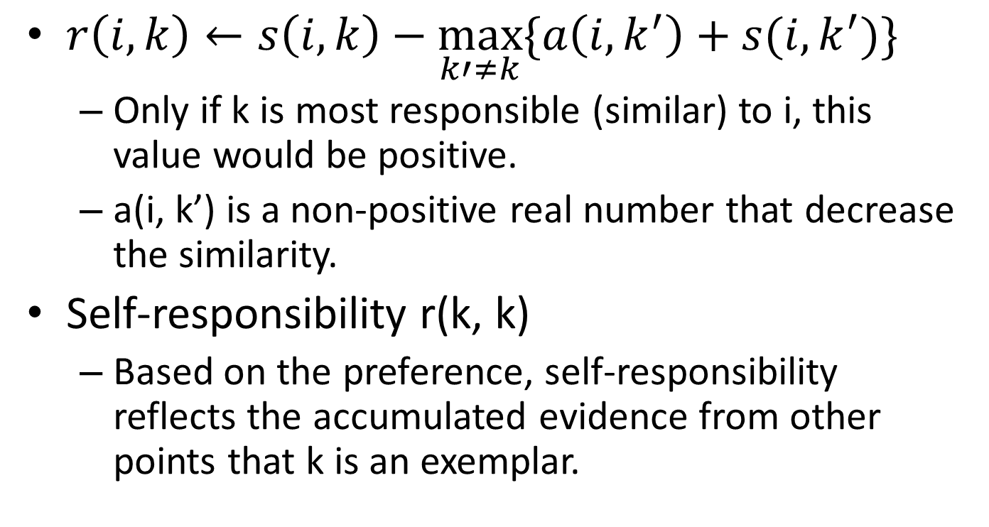
Responsibility Update Rules
$r\left(i, k\right)←s\left(i, k\right)−\max_{k′≠k}{\{a\left(i,k^{′}\right)+s(i,k^{′})\}}$
Only if k is most responsible (similar) to i, this value would be positive.
a(i, k’) is a non-positive real number that decrease the similarity.
Self-responsibility r(k, k)
Based on the preference, self-responsibility reflects the accumulated evidence from other points that k is an exemplar.

Slide 8
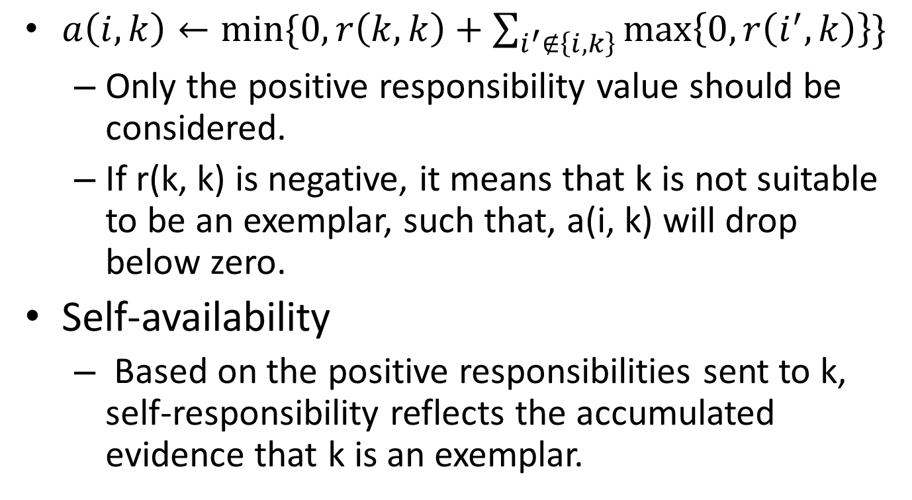
Availability Update Rules
$a\left(i, k\right)←min⁡\{0, r\left(k,k\right)+\sum_{i^{′}∉\left\{i,k\right\}}{\max\left\{0, r\left(i^{′},k\right)\right\}}\}$
Only the positive responsibility value should be considered.
If r(k, k) is negative, it means that k is not suitable to be an exemplar, such that, a(i, k) will drop below zero.
Self-availability
Based on the positive responsibilities sent to k, self-responsibility reflects the accumulated evidence that k is an exemplar.

Slide 9
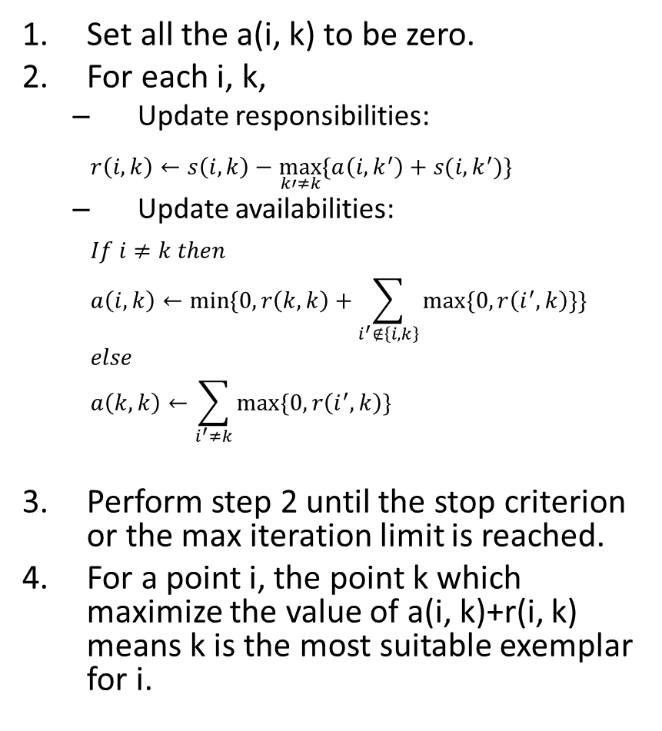
Affinity Propagation
Set all the a(i, k) to be zero.
For each i, k,
Update responsibilities:
$$r\left(i, k\right)←s\left(i, k\right)−\max_{k′≠k}{\{a\left(i,k^{′}\right)+s(i,k^{′})\}}$$
Update availabilities:
$$If i≠k then$$
$$a\left(i, k\right)←min⁡\{0, r\left(k,k\right)+\sum_{i^{′}∉\left\{i,k\right\}}{max⁡\{0, r\left(i^{′},k\right)\}}\}$$
$$else$$
$$a\left(k, k\right)←\sum_{i^{′}≠k}{max⁡\{0, r\left(i^{′},k\right)\}}$$
Perform step 2 until the stop criterion or the max iteration limit is reached.
For a point i, the point k which maximize the value of a(i, k)+r(i, k) means k is the most suitable exemplar for i.
Given a similarity matrix s including the preferences of data points. AP intends to find out a high-quality set of exemplars.
The process of AP is shown on the left side. r(i, k) stands for responsibility which transfers from i to k, and a(i, k) stands for availability which transfers from k to i.

Slide 10
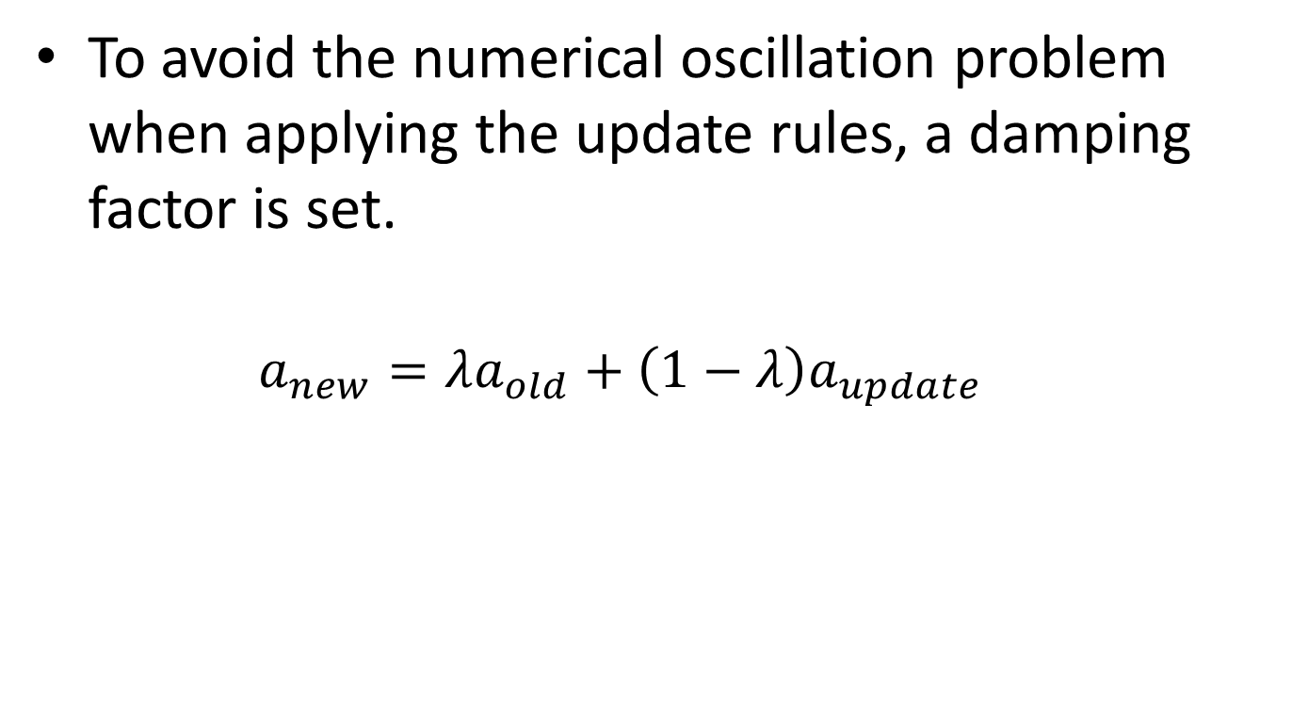
Numerical Oscillation
To avoid the numerical oscillation problem when applying the update rules, a damping factor is set.
$$a_{new}=λa_{old}+\left(1−λ\right)a_{update}$$

Slide 11
Classical Methods VS AP
K-means
Initial centers/exemplars
Number of clusters
HAC
Fortunate sequence of pairwise grouping
AP
Do not need to know the number of clusters
Preference to points

Slide 12
The End
Thank you very much!
The demo application of AP can be found in:
http://www.psi.toronto.edu/affinitypropagation/webapp/

